Slide 1


Name of Project
Air Quality Index Prediction Model with Python
BHAWANAND JHA
Internship ID: INTERNSHIP_1736246007677d02f700dbe

Slide 2

Learning Objectives
This Week taught us how to plot different graph types in Python using different libraries.
GOAL
Source :
www.freepik.com/

Slide 3
Tools and Technology used
In this project, Python was used as the primary programming language, and Matplotlib was utilized for generating various types of graphs. Matplotlib is a powerful library in Python for data visualization, allowing us to create different categories of graphs such as normal distribution, right-skewed, and left-skewed distributions.

Slide 4
Methodology
The approach involved the following steps:
1. Data generation: Random data points were generated to represent different distributions.
2. Graph plotting: Matplotlib was used to visualize the data in different formats.
3. Distribution types: Various types of distributions, including normal, right-skewed, and left-skewed, were analyzed and plotted.
4. Interpretation: The characteristics of each graph were examined to understand their significance.

Slide 5
Problem Statement:
The objective of this project is to generate and visualize different types of statistical distributions using Python and Matplotlib. The aim is to demonstrate how different data distributions appear and how they can be used for data analysis.

Slide 6
Solution:
Using Python and the Matplotlib library, different types of graphs were generated to represent various distributions. The solution involved:
- Creating synthetic data for each type of distribution.
- Using Matplotlib functions to plot histograms and density plots.
- Analyzing the differences between normal, left-skewed, and right-skewed distributions.

Slide 7
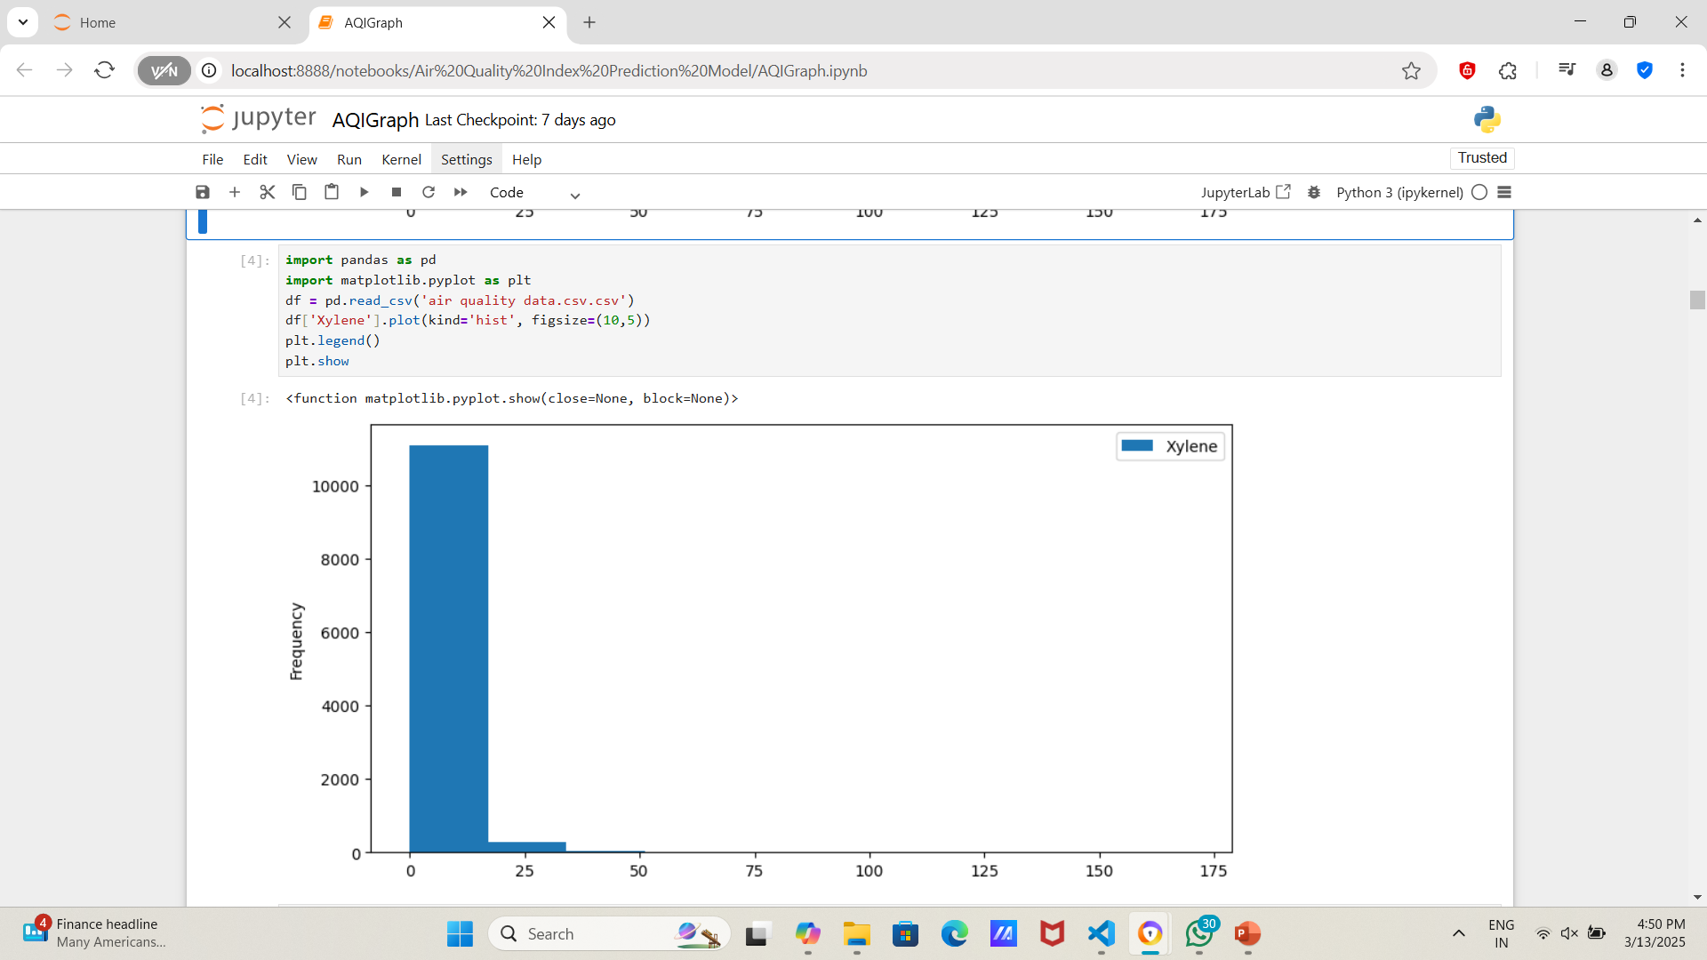
Screenshot of Output:

Slide 8
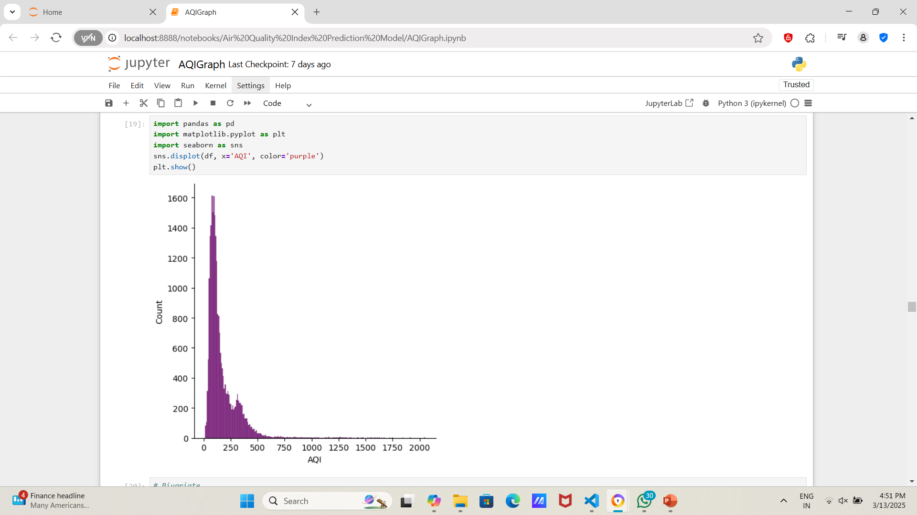
Screenshot of Output:

Slide 9
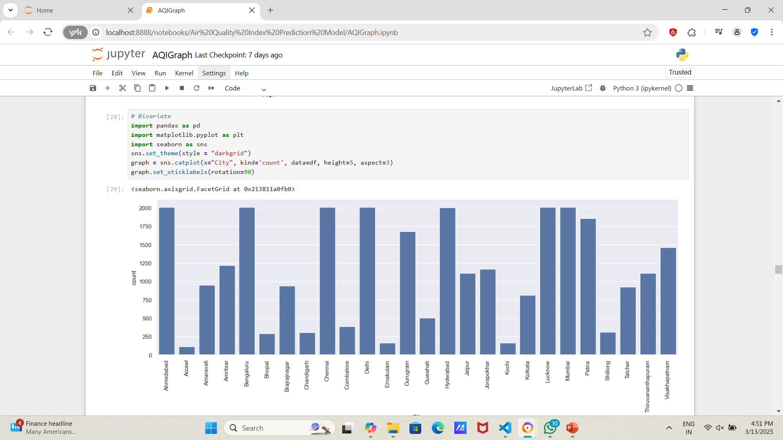
Screenshot of Output:

Slide 10
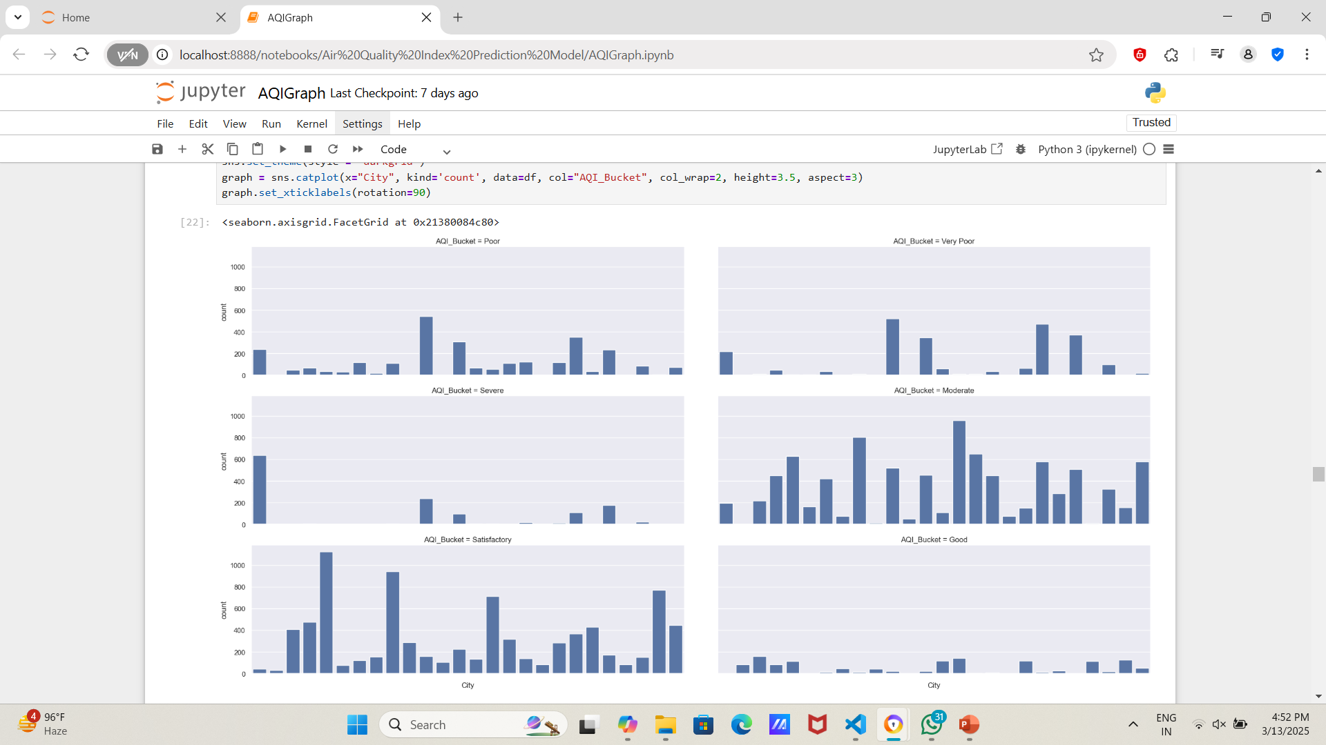
Screenshot of Output:

Slide 11
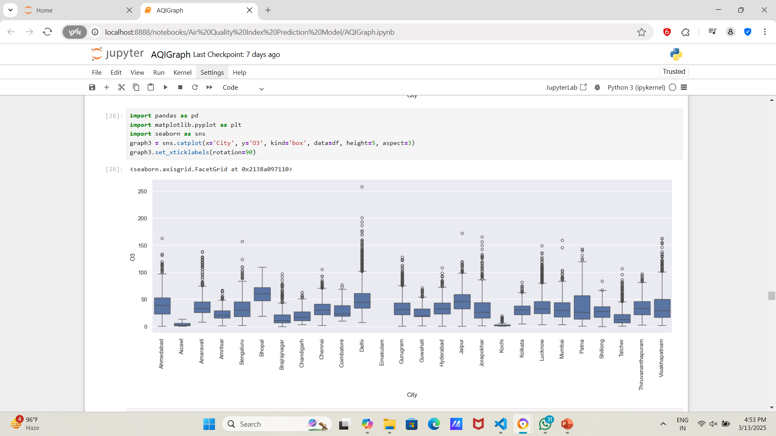
Screenshot of Output:

Slide 12
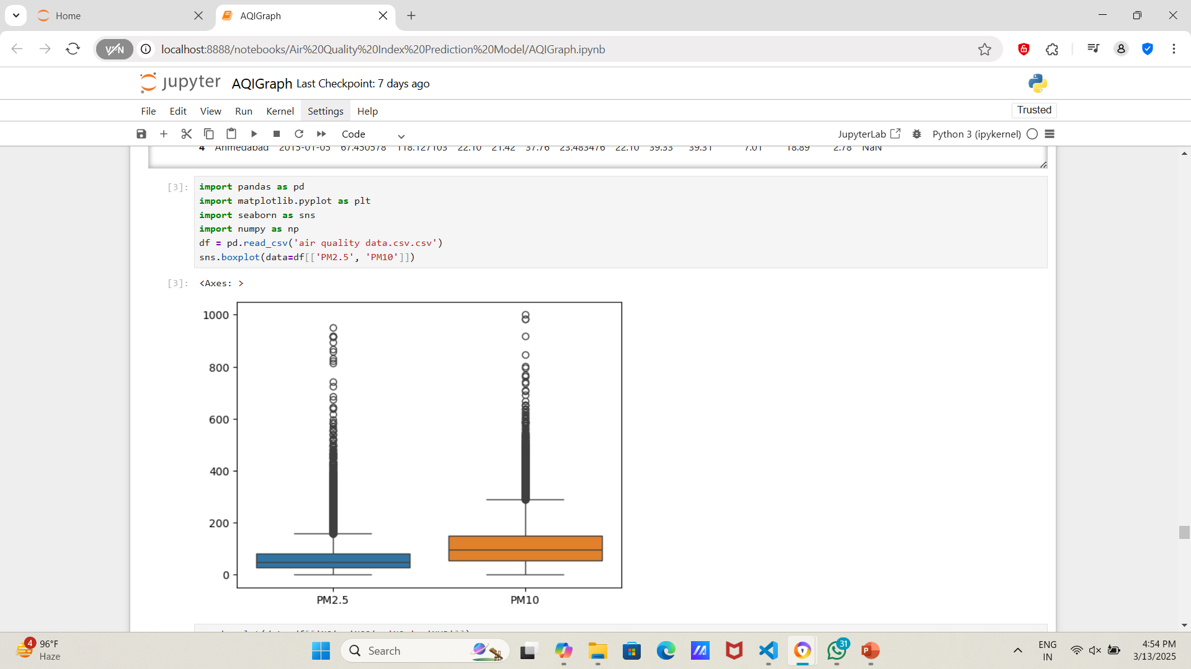
Screenshot of Output:

Slide 13
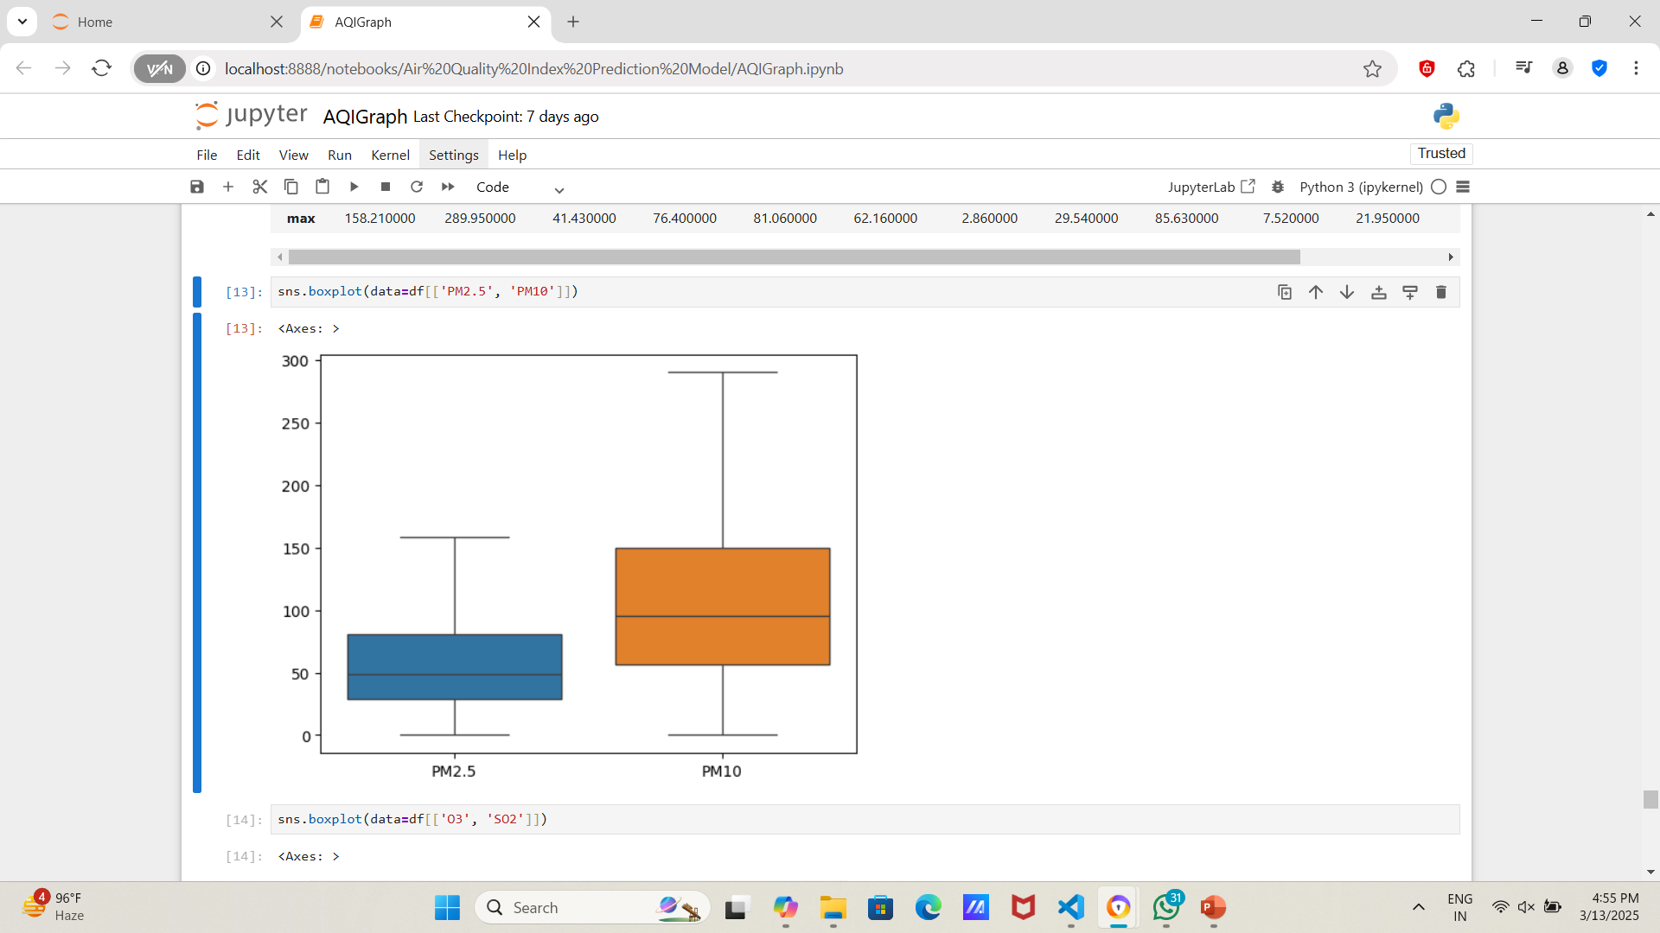
Screenshot of Output:

Slide 14
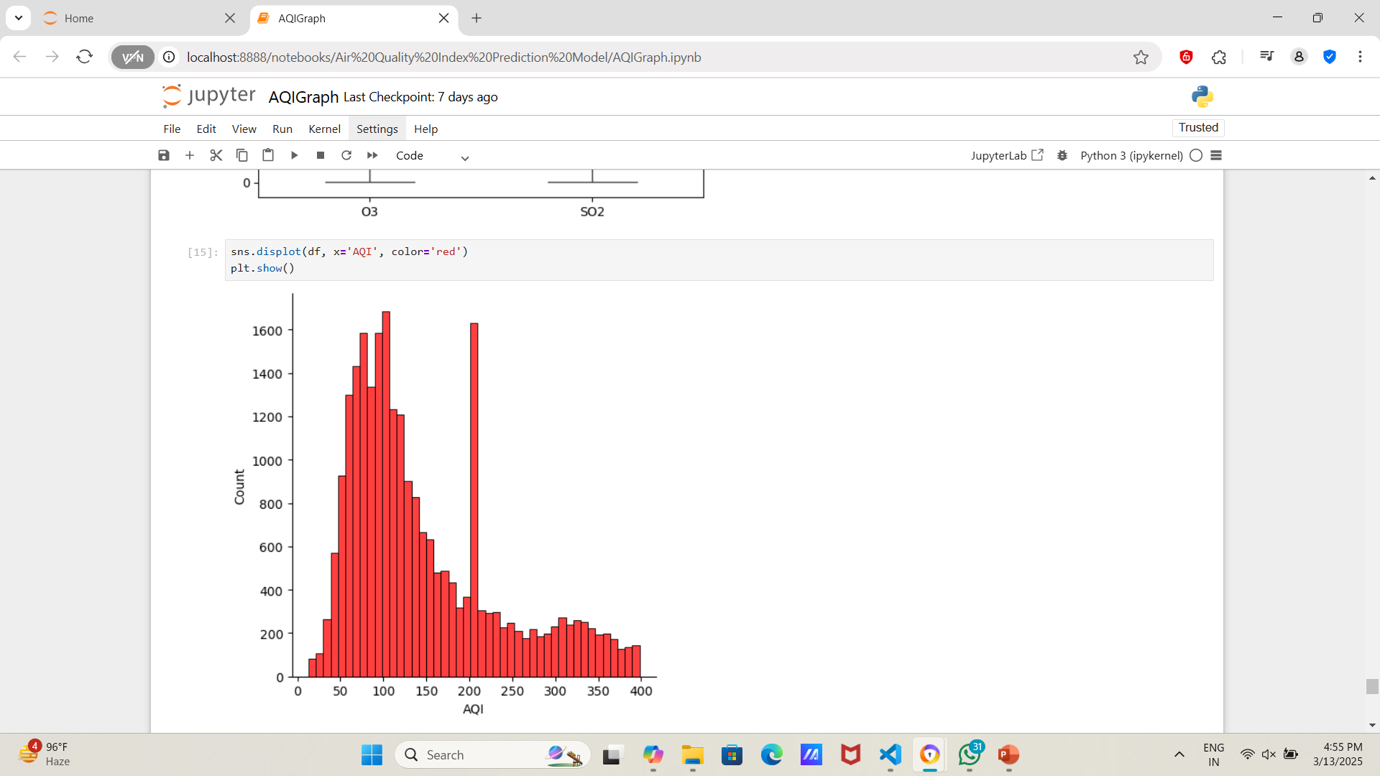
Screenshot of Output:

Slide 15
Conclusion:
This project successfully demonstrated the visualization of different types of distributions using Matplotlib in Python. The plotted graphs provide insight into how data is distributed and help understand the nature of datasets. This approach can be further extended to real-world applications, such as statistical analysis, predictive modeling, and data science tasks.

